Slide 1
3RD QUARTER BUDGET PERFORMANCE REPORT FOR 2020 FISCAL YEAR
PREPARED BY
KOGI STATE MINISTRY OF FINANCE, BUDGET AND ECONOMIC PLANNING

Slide 2
THIRD QUARTER BUDGET PERFORMANCE REPORT FOR 2020 FISCAL YEAR.
Preamble
Kogi State, as in the global community, has been ravaged by the effects of COVID-19 pandemic. The State Budget assumptions have been revised to reflect the prevailing realities of a significantly plummeted revenues (oil revenue and IGR). The effects of the general economic slowdown has shown visible negative impact on inflation, unemployment, exchange rate etc. The COVID regime ushered in new priorities, as the State is still contending with serious health issues as well as intensifying livelihood support, strengthening agricultural value chain, maintenance of rural infrastructure, completion of ongoing projects and initiation of few pro-poor projects. The State has also granted tax waiver to selected businesses to sustain them in business. As a result of the effects stated above, the earlier approved Budget of N176 Billion was revised to N102 Billion to make it implementable.

Slide 3
The above are the necessary reforms the State is undertaking to mitigate the effects of COVID-19. These measures, notwithstanding, the GDP has been projected to contract by 4.42% in 2020. The huge shortfalls in the State revenues would be helped by the World Bank SFTAS performance based grants with the maximum available sum of $18.5 Million, World Bank 2020 Budget Amendment Grant in the sum of $5 Million and World Bank CARES initiative in the sum of $20 Million (Maximum), all of which are loans from the World Bank to the Federal Government and to be given to states as performance based grants. The global economy presents great challenges. One of such is the ongoing cold war between the two largest economies of the world, USA and China. The cold war, if not checked, will mount significant pressure on the already overwhelmed global world economy over COVID-19 crisis. The US presidential election, billed for November 3rd 2020, will likely determine whether or not, there will be room for productive engagement or escalation. As a matter of fact, many countries of the world are technically in recession after experiencing two consecutive quarters of negative growth while others expected to follow suite, apart from China, which has recorded a growth rate of 4,9%.

Slide 4
In view of the above, the state of the world economy remains largely unpredictable, as only an early effective vaccine for COVID, can usher-in quick economic recovery process, including restoring some stability in the crude oil price as well as other development parameters such as GDP, unemployment, inflation etc. Despite this hugely challenging economic environment, the State remains committed to an amended Budget that is pro-poor focused and COVID-19 responsive, given the dwindling revenues to address originally approved Budget. This document, therefore, conveys the Budget Performance for the second quarter of 2020 fiscal year.
The total Revised Budget package for the State in the period under review was N102,123,091,931. Out of this, the sum of N25,530,772,983 was for the third quarter estimates i.e. from July-Sept, 2020 while N76,592,318,948 was for 3 cumulative quarters i,.e. from January to Sept, 2020. Of this amount, N16,381,334,877 and N49,144,004,632 were earmarked for recurrent services while N9,149,438,106 and N27,448,314,317 were for capital projects/programmes for both third quarter and 3 cumulative quarters.

Slide 5





RECURRENT REVENUE PERFORMANCE
The total recurrent revenue estimates for third quarter (July – September) and cumulative quarters (January – September), 2020 fiscal year were N21,053,950,944 and N63,161,852,833 (Internally Generated Revenue + Federation Accounts) respectively. However, the total sum of N19,582,722,118 and N55,021,325,931 were realized, representing 93.01% and 87.11% performance for both third quarter and cumulative quarters under review. Out of this amount realized, N4,684,806,301 and N12,119,791,901 came from Internally Generated Revenue Sources while N14,897,915,817 and N42,901,534,030 came from Federal Transfer. The breakdown of the actual revenue collected with the percentage performance during the periods under review are presented in the tables & graphs below.

Slide 6
RECURRENT REVENUE PERFORMANCE TABLE FOR 3RD QUARTER
S/NO A | DETAILS B | REVISED ESTIMATES 2020 C | REVISED ESTIMATES July–Sept. 2020 D | ACTUAL REVENUE AS AT 30/09/20 E | 3rd Qtr. Balances F | % PERFORMANCE (E/DX100) G
1 | OPENING BALANCE | 24,422,418,782 | 6,105,604,696 | 0 | 6,105,604,696 | 0.00
2 | INTERNAL REVENUE | 17,032,117,213 | 4,258,029,303 | 4,684,806,301 | (426,776,998) | 110.02
3 | STATUTORY ALLOCATION | 29,189,675,754 | 7,297,418,939 | 10,464,773,701 | (3,167,354,762) | 143.40
4 | SHARE OF VAT | 11,800,000,000 | 2,950,000,000 | 4,128,961,429 | (1,178,961,429) | 139.96
5 | EXCESS CRUDE | 120,000,000 | 30,000,000 | 0 | 30,000,000 | 0.00
6 | EXCHANGE DIFFERENCE | 200,000,000 | 50,000,000 | 304,180,687 | (254,180,687) | 608.36
7 | REFUND FROM FEDERAL GOVERNMENT | 130,893,199 | 32,723,300 | 0 | 32,723,300 | 0.00
8 | NON-OIL REVENUE | 600,000,000 | 150,000,000 | 0 | 150,000,000 | 0.00
9 | FOREX EQUALISATION | 600,000,000 | 150,000,000 | 0 | 150,000,000 | 0.00
10 | EXCESS BANK CHARGE | 120,698,829 | 30,174,707 | 0 | 30,174,707 | 0.00
Total |  | 84,215,803,777 | 21,053,950,944 | 19,582,722,118 | 1,471,228,827 | 93.01

Slide 7
Graphical Representation of Recurrent Revenue analysis for 3RD Quarter

Slide 8
RECURRENT REVENUE PERFORMANCE FOR CUMULATIVE QUARTERS
S/NO A | DETAILS B | REVISED ESTIMATES 2019 C | REVISED ESTIMATES JAN–Sept. 2020 D | ACTUAL REVENUE FROM Jan-Sept.2020 E | Cum. 3 Qtr Balance F | % PERFORMANCE (E/DX100) G
1 | OPENING BALANCE | 24,422,418,782 | 18,316,814,087 | 0 | 18,316,814,087 | 0.00
2 | INTERNAL REVENUE | 17,032,117,213 | 12,774,087,910 | 12,119,791,901 | 654,296,009 | 94.88
3 | STATUTORY ALLOCATION | 29,189,675,754 | 21,892,256,816 | 33,425,378,553 | (11,533,121,738) | 152.68
4 | SHARE OF VAT | 11,800,000,000 | 8,850,000,000 | 7,292,024,856 | 1,557,975,144 | 82.40
5 | EXCESS CRUDE | 120,000,000 | 90,000,000 | 0 | 90,000,000 | 0.00
6 | EXCHANGE DIFFERENCE | 200,000,000 | 150,000,000 | 1,126,181,230 | (976,181,230) | 750.79
7 | REFUND FROM FEDERAL GOVERNMENT | 130,893,199 | 98,169,899 | 0 | 98,169,899 | 0.00
8 | NON-OIL REVENUE | 600,000,000 | 450,000,000 | 239,549,769 | 210,450,231 | 53.23
9 | FOREX EQUALISATION | 600,000,000 | 450,000,000 | 809,660,874 | (359,660,874) | 179.92
10 | EXCESS BANK CHARGE | 120,698,829 | 90,524,122 | 8,738,747 | 81,785,375 | 9.65
Total |  | 84,215,803,777 | 63,161,852,833 | 55,021,325,931 | 8,140,526,903 | 87.11

Slide 9
Cumulative quarters Recurrent Revenue Analysis

Slide 10
From the above table, it is inevitable for the State to strengthen its revenue generation capacity as the state revenue is still largely dependent on its share of allocation from the Federation Accounts for her development programmes.
Based on this, reforms are continually being implemented to improve the State revenue status. The state is, therefore, putting in place new measures to increase IGR in line with approved estimates and will seek to review this stance in the fourth quarter of 2020

Slide 11
RECURRENT EXPENDITURE ANALYSIS FOR THIRD QUARTERS
The revised recurrent expenditure for the period under review (July-Sept 2020) was N16,381,334,877 while the actual for the same period was N12,418,838,066 representing 75.81% performance. The 2020 Revised Budget for the third quarter recurrent expenditure and the breakdown of the actual expenditure with the percentage performance are shown in the table below:
DETAILS OF RECURRENT EXPENDITURE PERFORMANCE
S/NO A | DETAILS B | REVISED ESTIMATES 2019 C | REVISED ESTIMATES July–Sept. 2020 D | ACTUAL EXPENDITURE AS AT 30/09/2020 E | 3rd Qtr. Balances F | % PERFORMANCE (E/DX100) G
1. | Personnel Cost including Statutory Office holders | 38,197,592,479 | 9,549,398,120 | 8,246,020,345 | 1,303,377,775 | 86.35
2. | Overhead Costs | 27,327,747,030 | 6,831,936,757 | 4,172,817,721 | 2,659,119,037 | 61.08
 | Total | 65,525,339,509 | 16,381,334,877 | 12,418,838,066 | 3,962,496,811 | 75.81

Slide 12
Recurrent Expenditure Analysis

Slide 13
CUMULATIVE QUARTERS RECURRENT EXPENDITURE PERFORMANCE
The revised recurrent expenditure for the period under review (January-Sept 2020) was N49,144,004,632 while the actual for the same period was N43,476,314,375 representing 88.47% performance. The 2020 Revised Budget for the cumulative quarters recurrent expenditure and the breakdown of the actual expenditure with the percentage performance are shown in the table below:
DETAILS OF RECURRENT EXPENDITURE PERFORMANCE
S/NO A | DETAILS B | REVISED ESTIMATES 2019 C | REVISED ESTIMATES Jan–Sept. 2020 D | ACTUAL EXPENDITURE from Jan.-Sept. 2020 E | Cum 3 Qtr Balance F | % PERFORMANCE (E/DX100) G
1. | Personnel Cost including Statutory Office holders | 38,197,592,479 | 28,648,194,359 | 24,632,646,150 | 4,015,548,209 | 85.98
2. | Overhead Costs | 27,327,747,030 | 20,495,810,273 | 18,843,668,225 | 1,652,142,048 | 91.94
 | Total | 65,525,339,509 | 49,144,004,632 | 43,476,314,375 | 5,667,690,257 | 88.47

Slide 14
Recurrent Expenditure Analysis

Slide 15


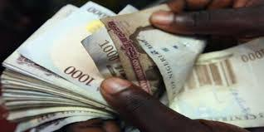

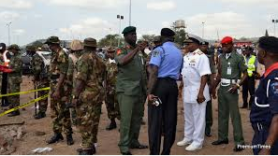

Personnel Costs
OVERHEAD COSTs
Internet Access Charges
Security
Travelling and Transport
Overhead Costs
Office Stationaries
Office Furniture & Fittings
Telephone Charge
Electricity Bill
Water Rate

Slide 16
THIRD QUARTER CAPITAL RECEIPTS (TRANSFER SURPLUS, GRANTS AND LOANS)
The total revised capital receipts for the year 2020 was N17,907,288,154 out of which the sum of N4,476,822,039 represents the third quarter figures (July-Sept., 2020). Out of this sum for the period under review, N3,387,681,264 was collected, representing 75.67% performance.
S/NO A | DETAILS B | REVISED ESTIMATES 2020 C | REVISED ESTIMATES July – Sept. 2020 D | ACTUAL REVENUE 30/09/20 E | 3rd Qtr Balance F | % PERFORMANCE (E/DX100) G
1 | Capital Receipt | 17,907,288,154 | 4,476,822,039 | 3,387,681,264 | 1,089,140,775 | 75.67

Slide 18
CUMULATIVE QUARTERS CAPITAL RECEIPTS (TRANSFER SURPLUS, GRANTS AND LOANS)
The total revised capital receipts for the year 2020 was N17,907,288,154 out of which the sum of N13,430,466,116 represents the third quarter figures (January-Sept., 2020). Out of this sum for the period under review, N16,860,323,854 was collected, representing 125.54% performance.
S/NO A | DETAILS B | REVISED ESTIMATES 2019 C | REVISED ESTIMATES Jan – Sept. 2020 D | ACTUAL REVENUE From Jan.-Sept. 2020 E | Cum. 3 Qtr Balance F | % PERFORMANCE (E/DX100) G
1 | Capital Receipt | 17,907,288,154 | 13,430,466,116 | 16,860,323,854 | (3,429,857,738) | 125.54

Slide 20
THIRD QUARTER CAPITAL EXPENDITURE ANALYSIS:
The total sum of N36,597,752,422 was revised for capital expenditure for the year 2020. Out of this, the sum of N9,149,438,106 was for the third quarter estimates (July-Sept, 2020) while the sum of N3,976,461,739 was the actual capital expenditure for the period, representing 43.46% performance.
Below is the tabular and graphical representation of this analysis

Slide 21
S/NO A | DETAILS B | REVISED ESTIMATES 2020 C | REVISED ESTIMATES July – Sept, 2020 D | ACTUAL EXPENDITURE AS AT 30/09/20 E | 3rd Qtr Balance F | % PERFORMANCE (E/DX100) G
1 | Capital exp. | 36,597,752,422 | 9,149,438,106 | 3,976,461,739 | 5,172,976,367 | 43.46

Slide 22
CUMULATIVE QUARTERS CAPITAL EXPENDITURE ANALYSIS:
The total sum of N36,597,752,422 was the revised capital expenditure for the year 2020. Out of this, the sum of N27,448,314,317 was for the cumulative quarters estimates (January-Sept, 2020) while the sum of N13,828,082,902 was the actual capital expenditure for the period, representing 50.38% performance.
Below is the tabular and graphical representation of this analysis

Slide 23
S/NO A | DETAILS B | REVISED ESTIMATES 2020 C | REVISED ESTIMATES Jan – Sept, 2020 D | ACTUAL EXPENDITURE From Jan.-Sept. 2020 E | Cumm 3 Qtr Balance F | % PERFORMANCE (E/DX100) G
1 | Capital exp. | 36,597,752,422 | 27,448,314,317 | 13,828,082,902 | 13,620,231,414 | 50.38

Slide 24
S/NO A | SECTOR B | REVISED ESTIMATES July – Sept, 2020 C | ACTUAL EXPENDITURE AS AT 30/09/20 D | 3rd Qtr. Balance E | % Performance
1 | Administrative | 1,432,486,710 | 72,236,178 | 1,360,250,532 | 5.04
2 | Economic | 4,002,047,020 | 2,648,081,450 | 1,353,965,570 | 66.17
3 | Law and Justice | 341,151,200 | 0 | 341,151,200 | 0.00
4 | Social Service | 3,373,753,175 | 1,256,144,110 | 2,117,609,065 | 37.23

Slide 25
S/NO A | SECTOR B | REVISED ESTIMATES Jan – Sept, 2020 C | ACTUAL EXPENDITURE From Jan.-Sept. 2020 D | Cum. 3 Qtr Balance E | % Performance F
1 | Administrative | 4,297,460,131 | 2,976,227,716 | 1,321,232,415 | 69.26
2 | Economic | 12,006,141,060 | 9,116,394,163 | 2,889,746,897 | 75.93
3 | Law and Justice | 1,023,453,600 | 0 | 1,023,453,600 | 0.00
4 | Social Service | 10,121,259,526 | 1,735,461,023 | 8,385,798,503 | 17.15

Slide 26
In conclusion,
The total revised revenue for 2020 fiscal year stands at N102,123,091,931. Out of this, the sum of N25,530,772,983 was for the third quarter estimates for both recurrent and capital receipts (July-Sept., 2020) while N76,592,318,948 was for the cumulative quarters for both recurrent and capital receipts (January-September, 2020). However, the total sum of N22,970,403,382 was realized, representing 89.97% performance for third quarter while N71,881,649,785 was realized, representing 93.85% performance for cumulative quarters.
On the other hand, the total Revised Budget expenditure for 2020 fiscal year was N102,123,091,931. Out of this, the sum of N25,530,772,983 was for the third quarter estimates for both recurrent and capital expenditure (January-September, 2020) while N76,592,318,948 was for the cumulative quarters for both recurrent and capital expenditure (January-September, 2020). However, the total sum of N16,395,299,805 was expended, representing 64.22% performance for third quarter while N57,304,397,277 was expended, representing 74.82% performance for cumulative quarters.

Slide 27
S/NO A | DETAILS B | REVISED ESTIMATES 2020 C | REVISED ESTIMATES July–Sept, 2020 D | ACTUAL REVENUE/EXP. AS AT 30/09/20 E | 3rd Qtr Balance F | % PERFORMANCE (E/DX100) G
1 | Revenue | 102,123,091,931 | 25,530,772,983 | 22,970,403,382 | 2,560,369,601 | 89.97
2 | Expenditure | 102,123,091,931 | 25,530,772,983 | 16,395,299,805 | 9,135,473,178 | 64.22

Slide 28
S/NO A | DETAILS B | REVISED ESTIMATES 2020 C | REVISED ESTIMATES Jan –Sept, 2020 D | ACTUAL REVENUE/EXP. From Jan-Sept. 20 E | Cum. 3 Qtr Balance F | % PERFORMANCE (E/DX100) G
1 | Revenue | 102,123,091,931 | 76,592,318,948 | 71,881,649,785 | 4,710,669,164 | 93.85
2 | Expenditure | 102,123,091,931 | 76,592,318,948 | 57,304,397,277 | 19,287,921,671 | 74.82

Slide 29






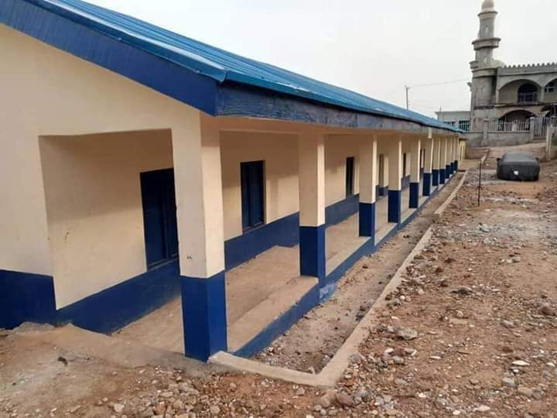
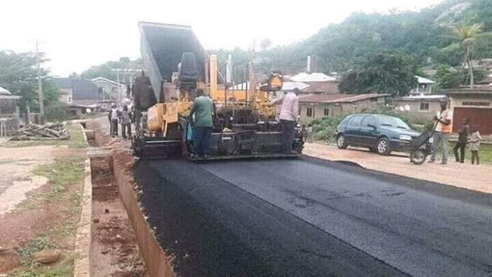
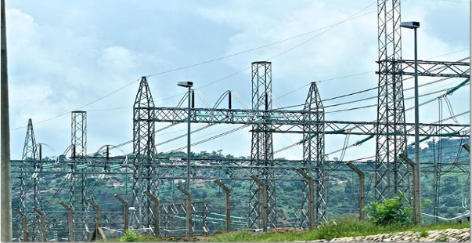

REVENUE
EXPENDITURE

Slide 30
2020 3RD QTR SUMMARY BUDGET ANALYSIS BY BUDGET CLASSIFICATION

Slide 31
2020 3RD QTR REVENUE ANALYSIS BY BUDGET CLASSIFICATION

Slide 53

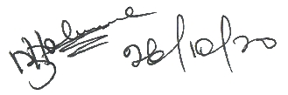
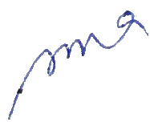

Having carefully analysed the actual data on Revenue and Expenditure submitted by the Office of Accountant General for the quarter under review vis-a-vis approved Budget for the same period, I hereby forward the Report for consideration and approval.
Compiled by Saeed AbdulLahi (Senor Budget Officer)----------------------------------------------------------------------------
Vetted by Mr. Olajide Samuel O. (Ag. Director Budget)------------------------------------------------------------------------
Recommended for Approval by Mallam Jimoh A. Muhammed (Permanent Sec.)-----------------------------
Approved by Mukadam Asiwaju Idris FCA (Hon. Commissioner)------------------------------------------------------

